Slide 1
ENPM808A – Introduction to Machine Learning
Final Project Presentation
Syed Mohammad Ibrahim
UID: 118428369

Slide 2
Problem Statement
Training a model using a dataset recorder by a car like robot to predict its linear and angular velocities

Slide 3
Feature Selection
The number of features present in the recording is about 1092.
To reduce the computational time and processing power, we need feature selection.
After feature selection, the number of features are reduced to 10 of 108 each.

Slide 4
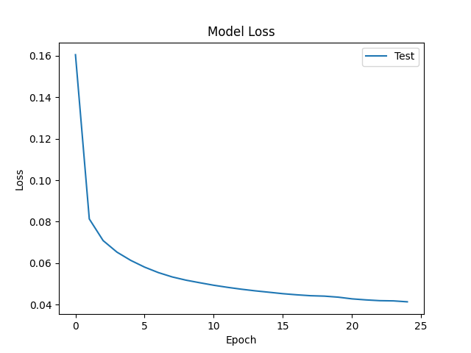
Model Selection and Validation
While Validating Deep Neural networks and linear regression for choosing the better model for training the larger data set, we get Different E_{in} from each model that aids us in choosing the better model
Linear Regression:
E_{in}: 0.0764, E_{val}: 0.0786, E_{out}: 0.08907
Neural Network:
E_{in}: 0.04027, E_{val}: 0.0483, E_{out}: 0.08084

Slide 5
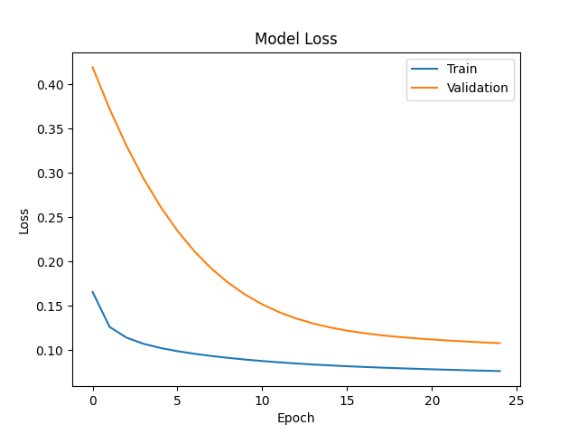
Training Neural Network
After model validation, the DNN model performs better and hence we train the model using the original data set D.
The Ein for one test scenario is shown here.

Slide 6
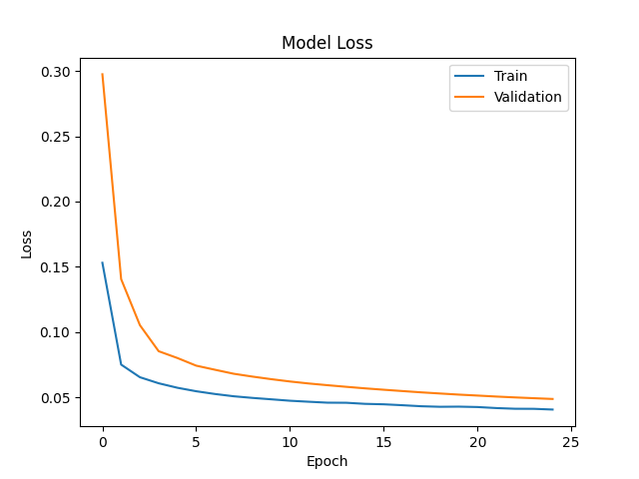
Hyperparameter Tuning and Regularization
I tried fitting the data using the hyperparameter tuning and regularization.
The regularization changes were unsuccessful as the MSE started increasing

Slide 7
Conclusion
We successfully compared two different models, decided the better model, and trained a DNN model for predicting the linear and angular velocities of the test data with minimal Ein.

